Slide 1
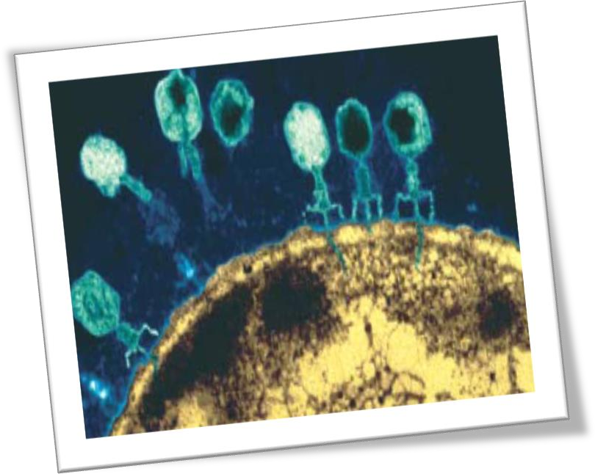
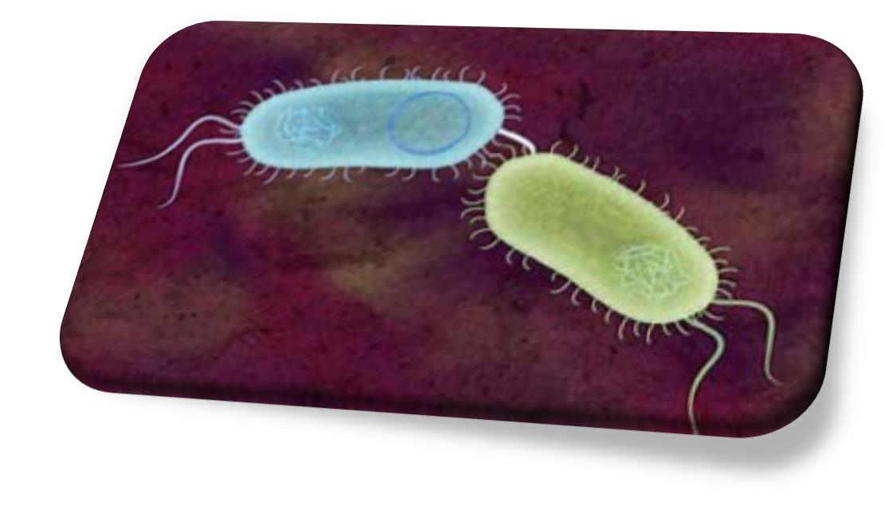


Slide 2
Why bacteria?
Because molecular biologists use bacteria as tools to carry most cloned genes.

Slide 3
6.1 Naked DNA Transformation
The broadest possible definition of sex = genetic material is transferred from one partner to the other.
Bacterial cells can take up naked DNA molecules and incorporate the genetic information they carry - TRANSFORMATION.
No actual cell to cell contact happens.

Slide 4
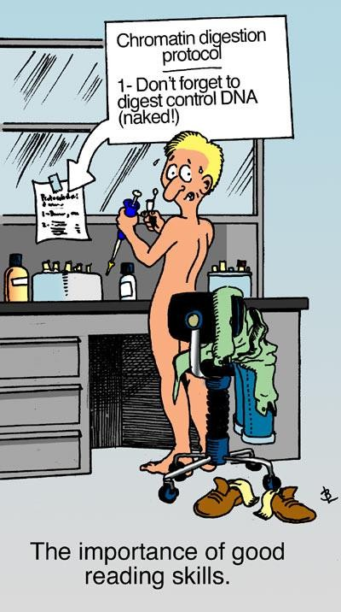
“Naked” DNA??
When a bacterial cell lyses, it releases its DNA into the environment (naked DNA).
http://peopleinwhitecoats.blogspot.com/2012/02/reading-skills.html

Slide 5
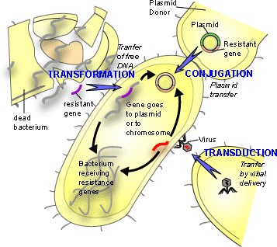
DNA transfer in bacteria

Slide 6
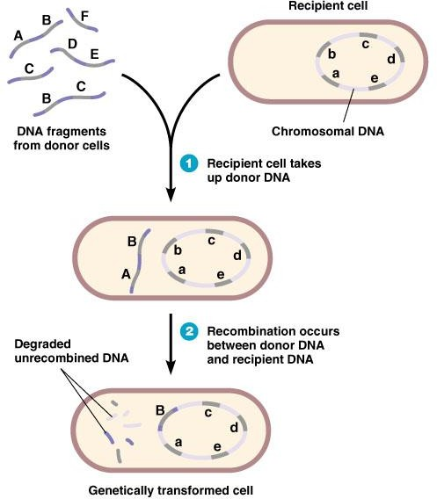
6.2 Transformation
DNA breaks into pieces on cell lysis.
DNA is taken up by the recipient cell.
A region of the recipient DNA is replaced by the donor DNA (recombination).
Unrecombined DNA is degraded.

Slide 7
6.2.1 Transformation is Used in Genetic Engineering
After genes or other useful segments of DNA have been cloned in the test tube, it is almost always necessary to put them into bacterial cell for analysis or manipulation.
Some bacteria readily take up outside DNA
- “competent” cells.
Other bacteria must be modified in the laboratory before they will take up DNA.

Slide 8
6.2.2 Methods of Transformation
Chemical treatment.
Chill the bacterial cells in the presence of chemicals such as CaCl₂/RbCl that can damage their cell walls, and then heat shock them to loosens the structure of the cell walls and allows DNA to enter.
Electroshock treatment - electroporation.
Bacteria are placed in an electroporator and zapped with a high voltage discharge.

Slide 9
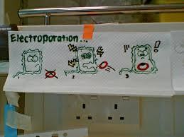
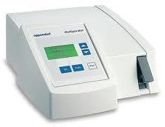
Electroporator
http://www.flickr.com/photos/adorare/775780547/

Slide 10
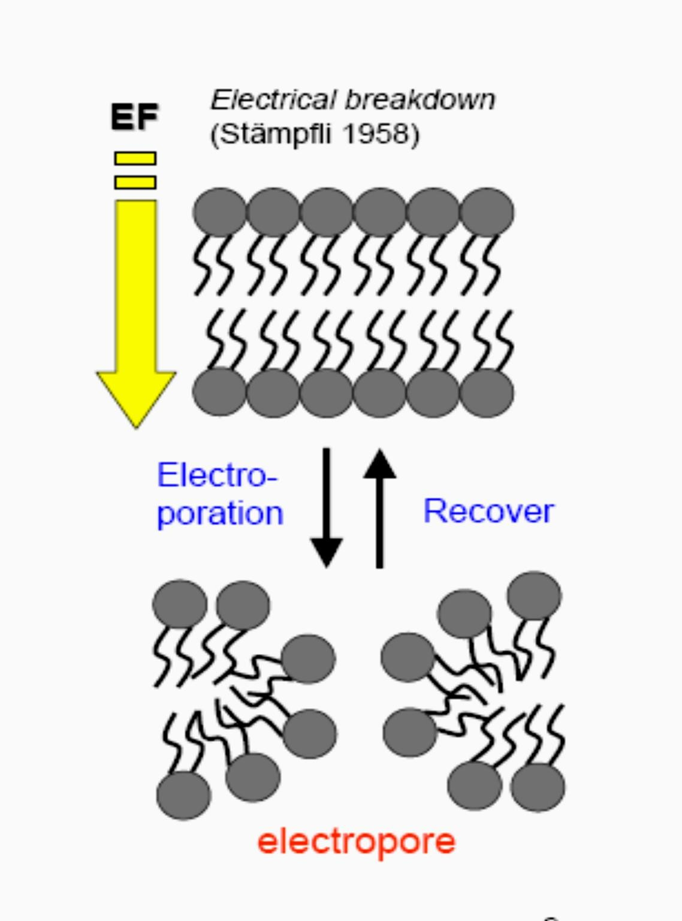

Slide 11
6.2.3 Competence
Alterations in the bacterial cell wall that makes it permeable to large DNA molecules.

Slide 12

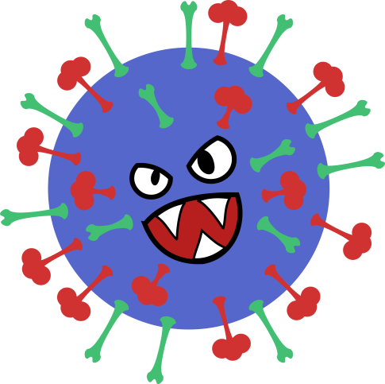
What Happens to the DNA After Uptake?
Two possibilities, failure or success -
> restriction or recombination.
Restriction: destruction of the incoming foreign DNA.
If foreign DNA comes from an enemy (e.g. virus), the DNA will be chopped up into small fragments by restriction enzyme. Transformation fails ☹
12
http://serioustohilarious.com/wp-content/uploads/2013/09/15732055-3d- cartoon-cute-monster.jpg
https://openclipart.org/image/2400px/svg_to_png/205972/Evil-Virus.png

Slide 13
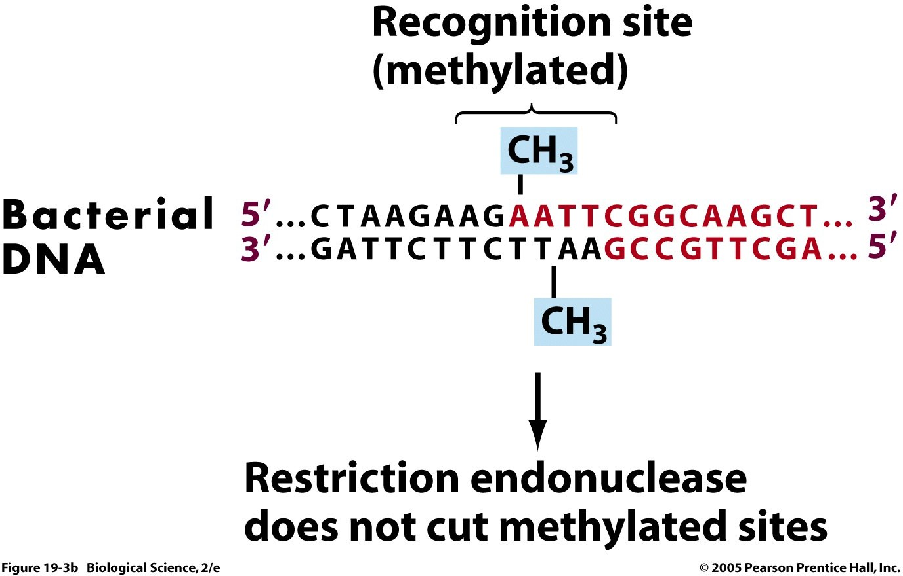
DNA that has been modified by closely related bacteria by adding the
correct chemical tags is accepted as friendly, in the form of a methyl (CH₃) group.
13
http://bio100.class.uic.edu/lectures/methylated.jpg

Slide 14
6.3 Recombination
• = Physical incorporation of some of the incoming DNA into the bacterial chromosome.
Some of the host cell's genetic information is replaced with genes from the incoming DNA and the bacteria are
permanently transformed.

Slide 15
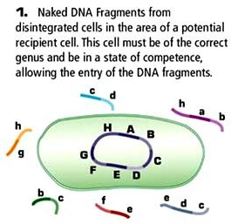

Slide 16
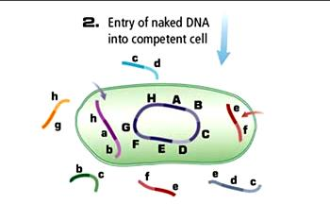

Slide 17
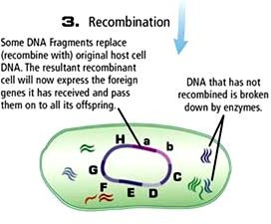

Slide 18
If the incoming DNA is part of a plasmid (own replication) recombination into the chromosome is not necessary.
In practice, it is usually convenient to avoid recombination, so molecular biologists normally put the genes they are working onto plasmids.

Slide 19
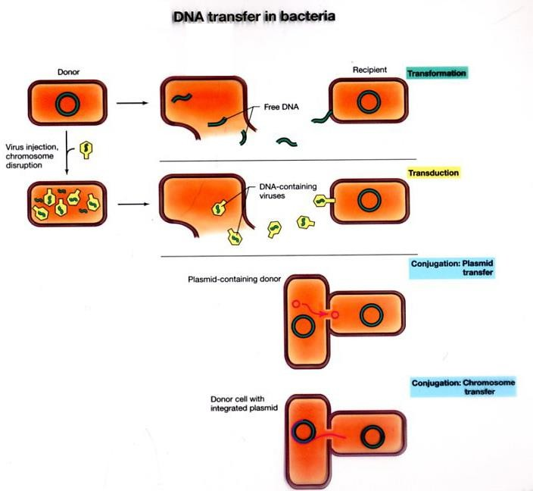

6.4 DNA Transfer in Bacteria

Slide 20
6.4.1 Transduction - Hitchhiking by Virus
When a virus succeeds in infecting a bacterial cell, it manufactures more virus particles, which contain a new copy of its own genes.
Occasionally, instead of packaging virus DNA into the virus particle, fragments of bacterial DNA get packaged.
This results in a defective particle.
The virus carrying bacterial DNA, may go on to infect another bacterial cell.

Slide 21
Then it injects DNA from the previous bacterial victim.
This DNA can be destroyed by restriction or incorporated by recombination (successful transduction).
Bacterial geneticists routinely carry out gene transfer between different bacteria by transduction using bacterial viruses, known as bacteriophage (or phage).

Slide 22
6.5 Is There Real Sex in Bacteria?
Conjugation - involves two cells, a
female recipient cell and a male donor cell.
The male has a long hollow, tubular organ referred to as sex pilus.

Slide 23
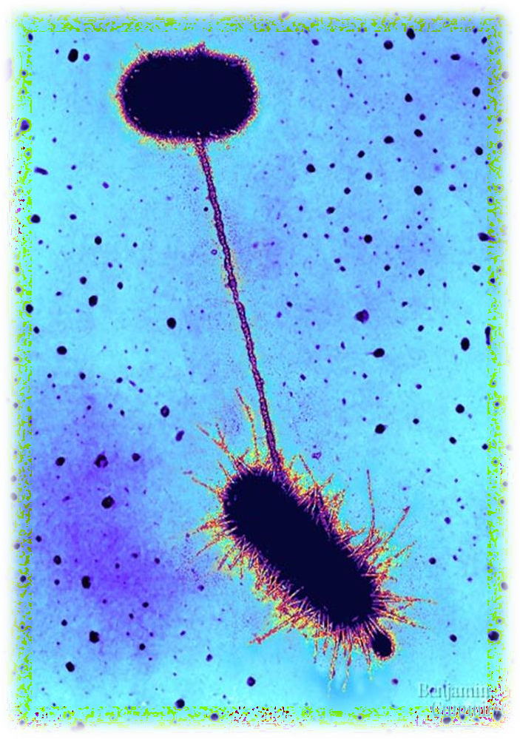
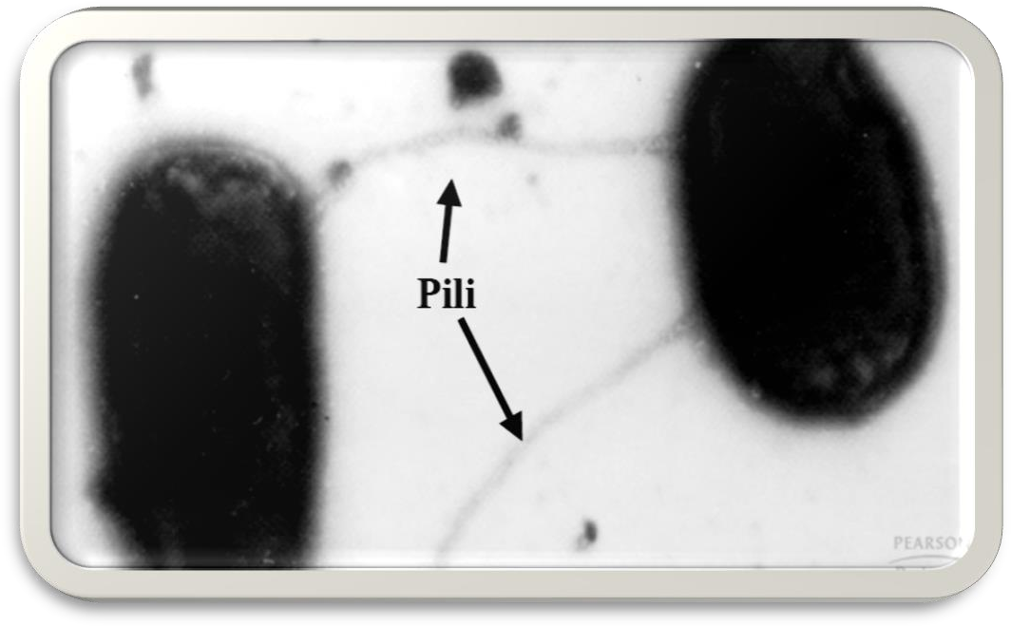
The male cell uses the pilus as a grappling hook to grab the female and pull her alongside.

Slide 24
The two cells then form a conjugation bridge when they touch and DNA goes from male into the female.
In practice, mating bacteria
snuggle together in groups of five to ten.

Slide 25





6.6 Plasmids
Small, circular molecules of DNA.
Replicate independently of the chromosome.
Usually dispensable for growth, but under some conditions provide a selective advantage such as antibiotic resistance or a unique metabolic pathway.
Conjugative plasmids carry genes for conjugation including sex pili.

Slide 26
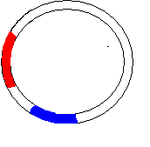

Plasmids which make a cell male are called
fertility plasmids.
The most famous - the F-plasmid of E. coli.
F- plasmid
Transfer (tra)
genes
Origin of transfer
Origin of
replication
Replicating
genes

Slide 27
The male donor cells are known as F⁺ and the female recipient F⁻.
Role in conjugation is determined by
the presence or absence of the F-plasmid.

Slide 28
6.6.2 Replication During Plasmid Transfer
Only one strand of the F-plasmid DNA is transferred.
The replication process:
One of the two strands of the double stranded DNA of the F-plasmid opens up at the origin of transfer.
This linearised single strand of DNA moves through the conjugation bridge into the female cell.

Slide 29
An unbroken single stranded circle of F- plasmid DNA remains inside the donor cell – used as a template for the synthesis of a new second strand to replace the one that just left.
As the linearised single strand of F- plasmid DNA enters the female cell, a new complementary strand of DNA is
made using the incoming strand as template.
When the female cell has received the F- plasmid it becomes F⁺ - a male!

Slide 30
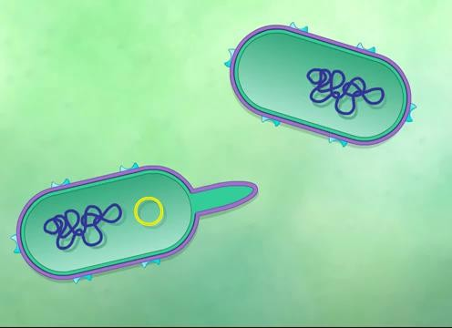

Slide 31






6.7 Transposition
• = the process of jumping from one DNA molecule to another.
To transfer chromosomal genes, a plasmid must first physically integrate itself into the chromosome of the bacterium.
The process of integration needs pairs of identical or nearly identical DNA sequences, one on the plasmid and the other on the bacterial chromosome.

Slide 32
Transposons/transposable elements/jumping genes
• = segments of DNA that can move as a unit from one location to another.
Transposons are always inserted into other DNA so they are never free as separate molecules.

Slide 33








Simple transposons cannot replicate themselves.
As long as the DNA molecule of which the transposon is part gets replicated, the transposon will also be replicated.
If the transposon inserts itself into a DNA molecule with no future, the transposon dies with it.

Slide 34
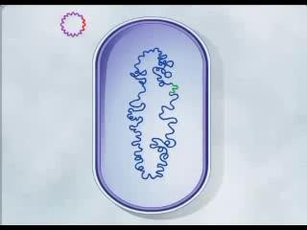

Slide 35
6.8 Plasmids: How Were They Discovered?
Plasmids were discovered in Japanese bacteria just after World War II. They were responsible for the problem known as transmissible antibiotic resistance.
Dysentery due to bacteria was originally treated
with sulfonamides, the earliest type of antibiotic.
It wasn't long before human were attacked again as bacteria resistant to these antibiotics began
to appear!
Once resistance had arisen, it was transferred from one strain of bacteria to another at a high frequency.

Slide 36





It turned out that the genes for antibiotic resistance is carried from one bacterium to another on plasmids.

Slide 37
A Typical R-plasmid
Transfer genes
Replication
genes
R-plasmid
Antibiotic Resistant genes

Slide 38
The plasmid replicates itself along with the host chromosome.
At cell division, each daughter cell gets a copy of the plasmid as well as its own chromosome.

Slide 39
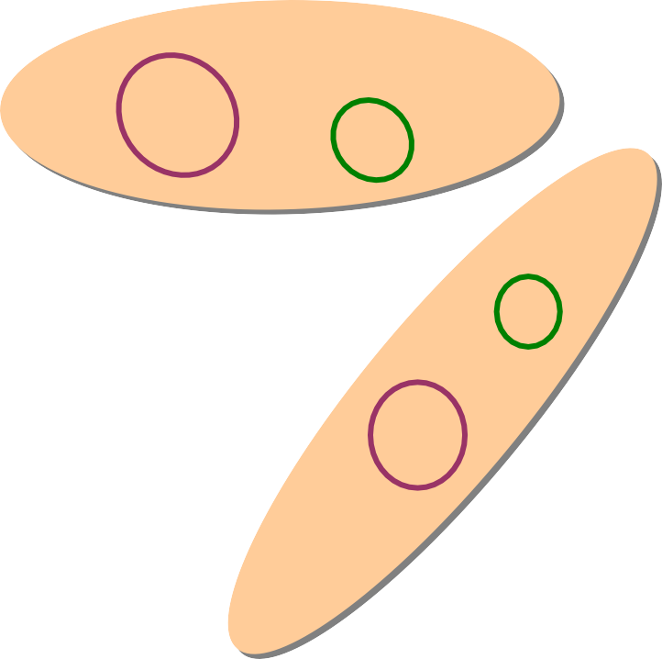

Plasmid DNA
Bacterial
chromosome
Cell division
Daughter
cells
39

Slide 40
The host range of plasmids varies widely.
Some plasmids are restricted to a few closely
related bacteria; others have a wide host range.
F-plasmid only inhabits E. coli and related enteric bacteria like Shigella and Salmonella.
P-plasmid can live in hundreds of different types of
bacteria.
P-type plasmids - originally discovered in bacteria Pseudomonas, which sometimes infect patients with severe burns. Often responsible for resistance to multiple antibiotics including penicillins.

Slide 41
Plasmid Compatibility
When a plasmid settles down to live in a bacterial
cell, it becomes very possessive of its home.
The resident plasmid keeps out other closely related
plasmids.
Two plasmids belonging to the same family cannot co-exist in the same bacterial cell - incompatibility.

Slide 42
The families are known as incompatibility groups.
Designated by letters of the alphabet, e.g. F-type plasmids include the F-plasmid and its relatives.
Plasmids of the same incompatibility group have aImost identical DNA sequences in their genes for replication, although the genes they carry for optional characteristics may be very different.

Slide 43

It is possible to have two, or even more, plasmids in the same cell as long as they belong to different families.
A P-type plasmid will happily share the same cell
with an F-type.
F
F
FF
P
P
P
NOT ALLOWED
ALLOWED

Slide 44
6.9 Movement of Plasmids
Transferability - the ability of certain plasmids to transfer themselves from one bacterial cell to another.
Need to manufacture a sex-pilus and form
a conjugation bridge with a suitable recipient cell.
Many medium size plasmids (F-type and P-type)
can do this - referred to as Tra+ (transfer positive).
Since plasmid transfer requires the operation of a large number of genes, only medium or large plasmids possess this ability.
Very small plasmids (e.g. ColE-plasmids), do not have enough DNA to carry the genes needed.

Slide 45



Although small plasmids cannot transfer themselves, they can sometimes hitch a ride with larger plasmids- known as mobilisability.
The ColE1 plasmid can be mobilised by the F-
plasmid.

Slide 46
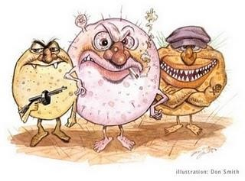
End of Chapter 6!

